Slide 1
Effective prevention and prediction of air pollution caused by automobiles using Iot and data analytics techniques
TEAM:
ADARSH RAJ(1MS12CS005)
ANVITHA D RAO (1MS12CS010)
VISHAL MAHULI (1MS12CS134)
VISHWANATH (1MS12CS135)
PROJECT GUIDE:
Dr. S SEEMA
ASSOCIATE PROFESSOR,
DEPARTMENT OF COMPUTER SCIENCE,
MSRIT.

Slide 2
AGENDA
Introduction
Problem statement
System Requirements
Literature Survey
Design
Project Plan for the Remaining Work
Conclusion
Reference

Slide 3
Introduction
Air pollution is the introduction of particulates, biological molecules, or other harmful materials into Earth's atmosphere, causing diseases to humans, damage to other living organisms such as animals and food crops, or the natural or built environment.
The air pollution from vehicles in urban areas, particularly in big cities, has become a serious problem. With the increase in the number of vehicles due to urbanization, air pollution has increased rapidly in the past few years.
The health risks of air pollution are extremely serious leading to various diseases such as cancer, asthma ,Cardiovascular Disease, diabetes, bronchitis and also putting the elderly and the kids at a higher risk. As a result various measures are taken to reduce the vehicular pollution.

Slide 4
The factors that contribute to vehicular pollution are poor fuel quality, old vehicles, inadequate maintenance, old automotive technologies and traffic management.
In this system we are trying to control the emission of poisonous gases due to incomplete combustion which can be achieved by restricting the fuel supply to the engine when the level of pollutant let out by the vehicle exceeds the predefined safe value.

Slide 5
The dataset collected for the analysis of air pollution in Bangalore has been collected from the Karnataka State Pollution Control Board (KSPCB) and other cities data regarding the air pollution has been collected from Mrs Sunita Narain, a Padma Shri winner for her excellent work and dedication as an environmentalist. She is a major proponent of the Green concept of the sustainable development.
She is currently the director general of the Centre of Science and Environment and the director of the Society for Environmental Communications.
The project carries a social as well as environmental impact and hence carries a huge responsibility.
The project has been shortlisted and selected for funding by the MSRIT ALUMUNI ASSOCIATION.

Slide 6
Problem statement
Air Pollution is the presence in the ambient atmosphere of substances that interfere in the normal health of the life forms and quality of the substances causing hazards in both. The problem ahead of us mainly is to develop a technical solution for the air pollution occurred due to the usage of automobiles. Problems include:
1) Taking only Bangalore into consideration, we have so many areas like Peenya, AMCO, White Field, Yeshwatnhpur etc. affected by air pollution heavily and major contributor to that is vehicular pollution.
How to reduce the emission of toxic gases from vehicles?
2) How to assist the owners of automobile in notifying them about the emission of their automobile and harm caused by it to the surroundings?
3) How to provide an efficient way to select upon a less polluted route between two areas?
4) How to frequently notify people about the increasing pollution in specific areas and provide solutions to reduce it?
5) Most importantly, how to deploy technology in solving the above mentioned problems?

Slide 7
System requirements
Sensors:
MQ7 –CO Sensor
Sensitive material of MQ-7 gas sensor is SnO2, which with lower conductivity in clean air. It detects by method of cycle high and low temperature, and detect CO when low temperature (heated by 1.5V).
The sensor’s conductivity increases along with the increasing gas concentration.
When high temperature (heated by 5.0V), it cleans the other gases adsorbed under low temperature.
MQ-7 gas sensor has high sensitivity to Carbon Monoxide. The sensor could be used to detect
different gases containing CO, it is cost effective and suitable for different application.

Slide 8
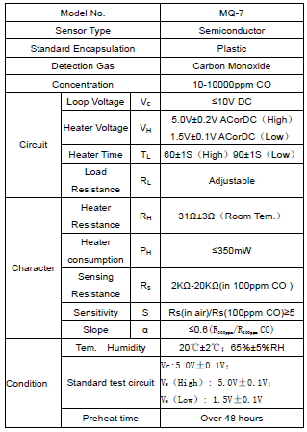
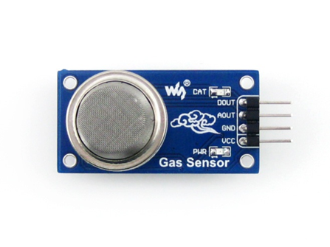

Slide 9
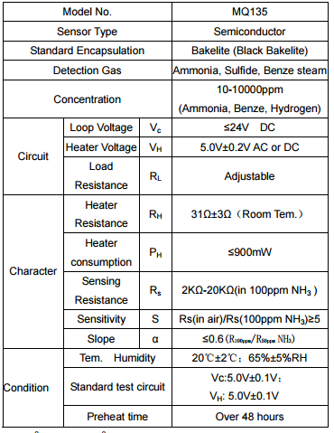
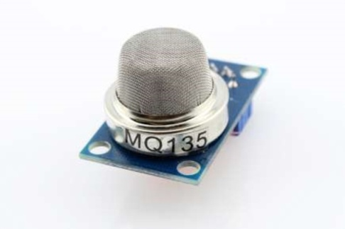
MQ135 GAS Sensor
MQ135 Semiconductor Sensor for Air Quality Control Sensitive material of MQ135 gas sensor is SnO2, which with lower conductivity in clean air. When the target combustible gas exist, The sensor’s conductivity is more higher along with the gas concentration rising.
MQ135 gas sensor has high sensitivity to Ammonia, Sulfide and Benzene steam, Nox and also sensitive to smoke and other harmful gases. It is with low cost and suitable for different application.

Slide 10
PROCESSOR BOARD: AURDUINO
Arduino is an open-source prototyping platform based on easy-to-use hardware and software. Arduino is an open-source computer hardware and software company, project and user community that designs and manufactures microcontroller-based kits for building digital devices and interactive objects that can sense and control objects in the physical world.
Arduino boards are able to read inputs - light on a sensor, a finger on a button, or a Twitter message - and turn it into an output - activating a motor, turning on an LED, publishing something online. You can tell your board what to do by sending a set of instructions to the microcontroller on the board. Arduino consists of both a physical programmable circuit board (often referred to as a microcontroller) and a piece of software, or IDE (Integrated Development Environment) that runs on your computer, used to write and upload computer code to the physical board
The Uno board can be powered via the USB connection or with an external power supply. The power source is selected automatically. The board can operate on an external supply from 6 to 20 volts. The ATmega328 has 32 KB (with 0.5 KB occupied by the boot-loader). It also has 2 KB of SRAM and 1 KB of EEPROM (which can be read and written with the EEPROM library).

Slide 11
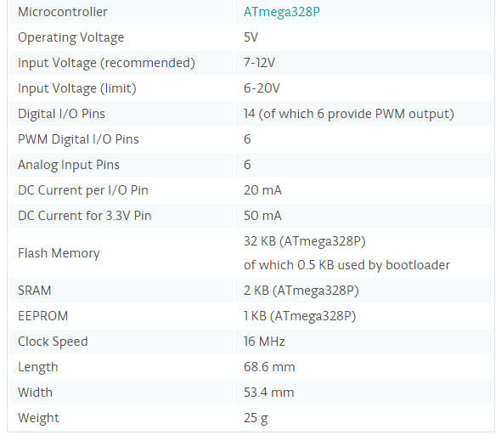
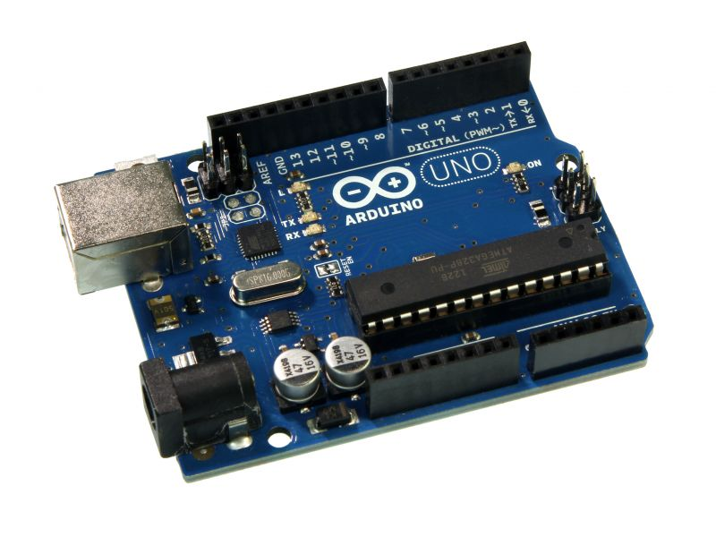

Slide 12
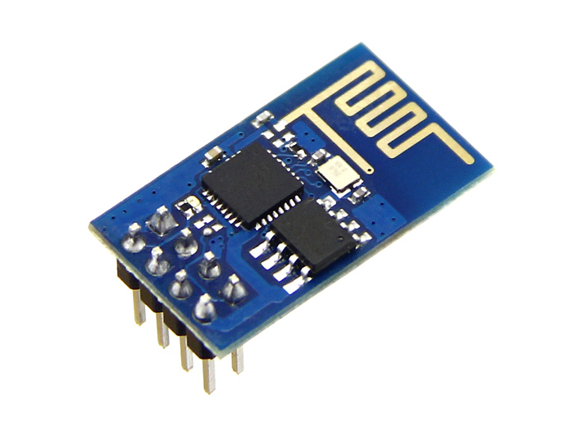
. ESP8266 Wi-Fi Module:
32-bit RISC CPU: Tensilica Xtensa LX106 running at 80 MHz
64 KiB of instruction RAM, 96 KiB of data RAM
External QSPI flash - 512 KiB to 4 MiB (up to 16MiB is supported)
IEEE 802.11 b/g/n Wi-Fi
Integrated TR switch, balun, LNA, power amplifier and matching network
WEP or WPA/WPA2 authentication, or open networks
16 GPIO pins
SPI, I²C,I²S interfaces with DMA (sharing pins with GPIO)
UART on dedicated pins, plus a transmit-only UART can be enabled on GPIO2.

Slide 13
GSM Board: SIM900
This is a GSM/GPRS-compatible Quad-band cell phone, which works on a frequency of 850/900/1800/1900MHz and which can be used not only to access the Internet, but also for oral communication (provided that it is connected to a microphone and a small loud speaker) and for SMSs.
The module is managed by an AMR926EJ-S processor, which controls phone communication, data communication (through an integrated TCP/IP stack), and (through an UART and a TTL serial interface) the communication with the circuit interfaced with the cell phone itself.
The processor is also in charge of a SIM card (3 or 1,8 V) which needs to be attached to the outer wall of the module. In addition, the GSM900 device integrates an analog interface, an A/D converter, an RTC, an SPI bus, an I²C, and a PWM module.
The TTL serial interface is in charge not only of communicating all the data relative to the SMS already received and those that come in during TCP/IP sessions in GPRS (the data-rate is determined by GPRS class 10: max. 85,6 kbps), but also of receiving the circuit commands (in our case, coming from the PIC governing the remote control) that can be either AT standard or AT-enhanced SIMCom type. The module is supplied with continuous energy (between 3.4 and 4.5 V) and absorbs a maximum of 0.8 A during transmission.

Slide 14
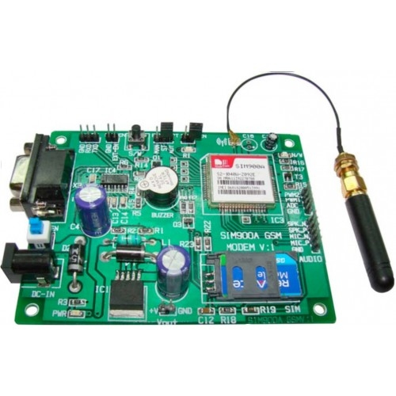

Slide 15
Literature survey
As our concentration is on prevention and prediction of air pollution from automobiles, we use two gas sensors i.e. MQ-7 and MQ-135. MQ-7 is a basically as CO gas sensor as CO is one of the primary content in the vehicular exhaust.
Anita Kulkarni et.al discussed in her paper and says that theirs is a real time work where a demo application has been made in which Arduino processor is used and a controller board is made where all these devices get integrated and work accordingly[1,2].
Sandeep S. Patil et.al discusses that when a vehicle attains certain threshold pollution level then an SMS is generated and sent to the pre-defined number stored in the memory through the GSM module about the time period which he has been allotted for the servicing of the vehicle [4].

Slide 16
Imran Zualkernan et.al also states that the aim of [2] is that the system is based on a smart sensor microcontroller equipped with a network capable application processor that downloads the pollutants level to a personal computer for further processing. The system monitors and transmits parameters atmospheric environment to a command center (admin’s server).
Further, even Dr. M Devapriya et.al also [3] gives us insights about the power management for the system. Also from this paper, we came up with the thought of having an android application which will provide you with routing between areas not based on traffic but based on pollution levels. This android application will also be the means of spreading the awareness about the control of air pollution by our “Tip of the day/week” feature of the system.

Slide 17
SYSTEM
ARCHITECTURE

Slide 18
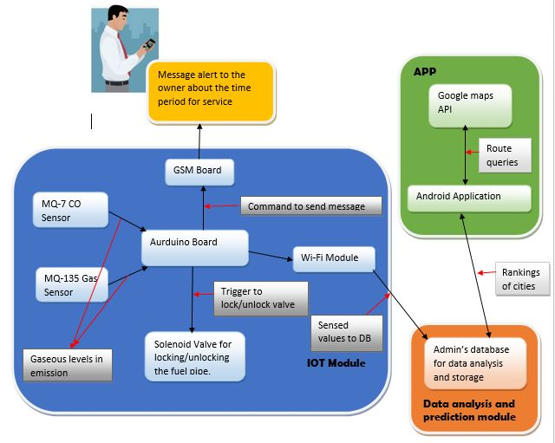

Slide 19
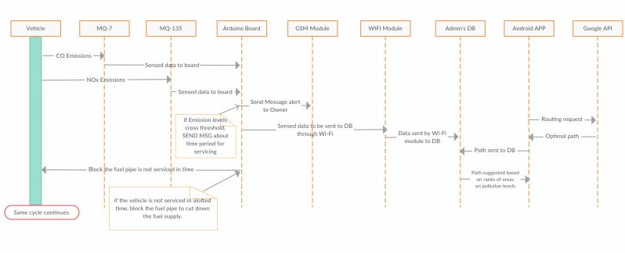
Design
Sequence diagram:

Slide 20
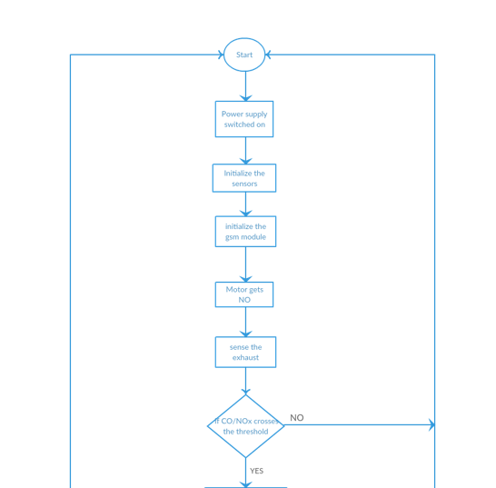
Data flow diagram:

Slide 21
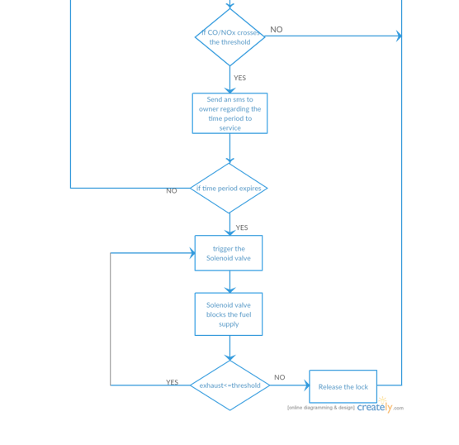

Slide 22
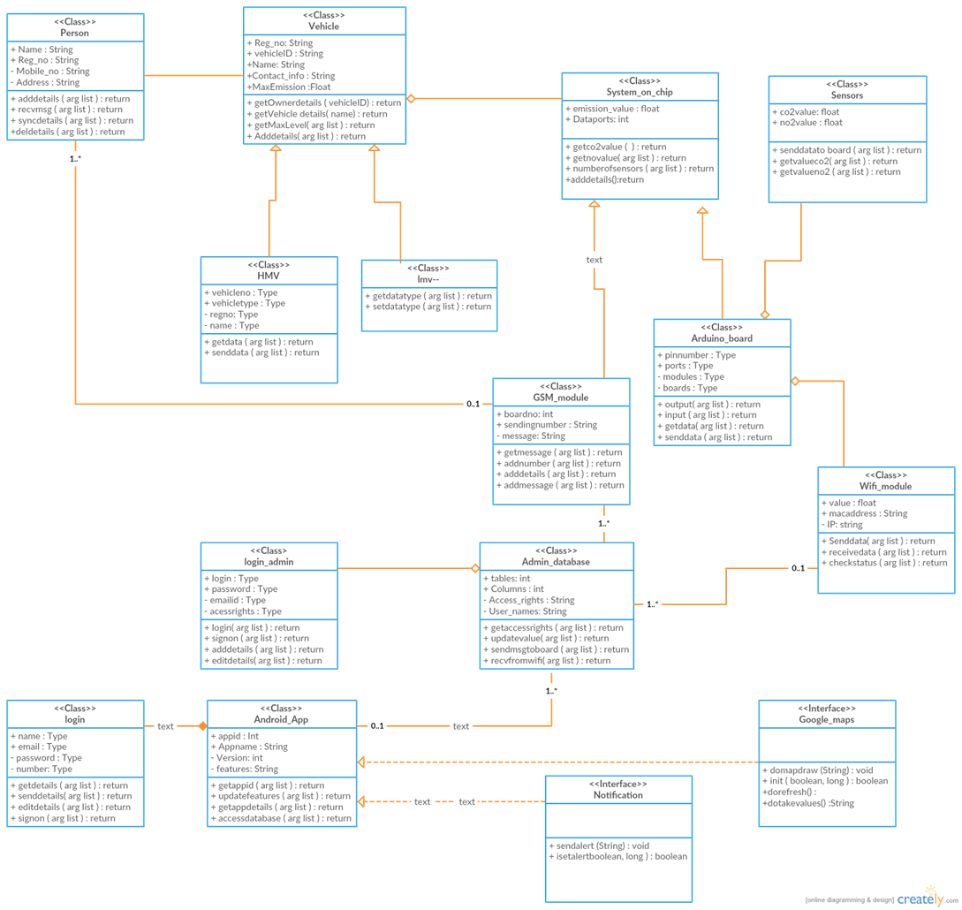
Class diagram:

Slide 23
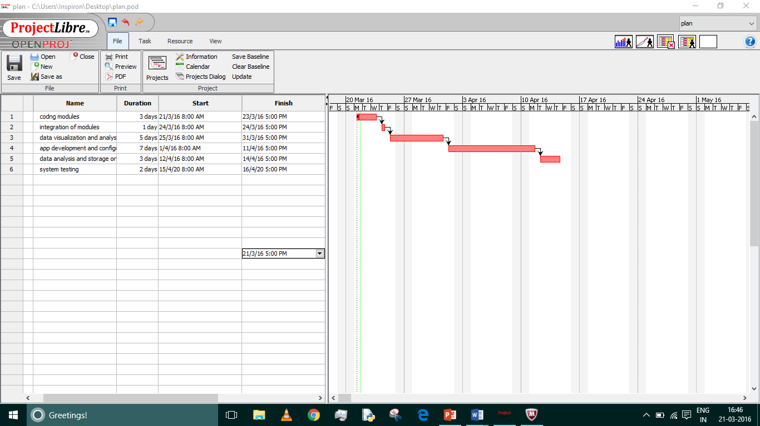
Project plan (remaining work)

Slide 24
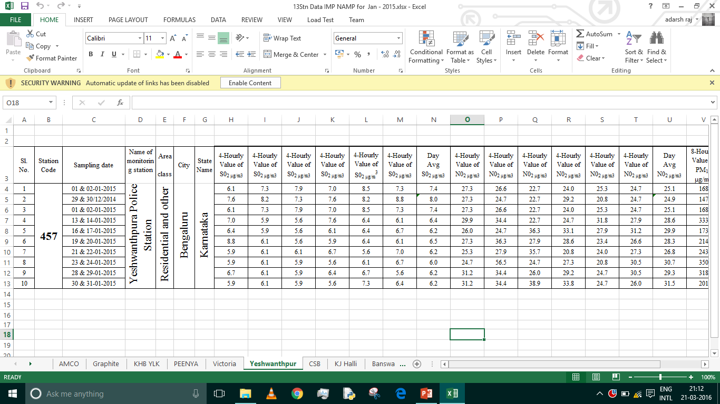
Dataset snapshot

Slide 25
conclusion
Air pollution is a major issue in the modern world due to increase in population and luxurious living.
The project has got its own social and environmental impact.
It is necessary to apply technology to solve burning issues like this of which the project work is an attempt in which we do the analysis of the data collected and provide the prediction for various areas along with the technical solution for vehicles through IoT sensors.
This solution is an attempt to curtail the air pollution rate and provide an analysis of the data collected and to spread awareness about the issue.
The solution proposed is eco-friendly and cost effective and hence, proves to be an optimal solution.

Slide 26
references
Anita kulkarni1 , T. Ravi Teja2 Associate Professor, Department of EIE, VNR Vignana Jyothi Institute of Engineering and Technology, Bachupally, Hyderabad, Telangana, India1 PG Student [EI], Department of EIE, VNR Vignana Jyothi Institute of Engineering and Technology, Bachupally, Hyderabad, Telangana, India2.
“Automated System for Air Pollution Detection and Control in Vehicles” in International Journal of Advanced Research in Electrical, Electronics and Instrumentation Engineering on 9, September 2014.
A. R. Al-Ali, Member, IEEE, Imran Zualkernan, and Fadi Aloul, Senior Member, IEEE
“A Mobile GPRS-Sensors Array for Air Pollution Monitoring”.
R.A.Roseline , Dr.M.Devapriya2 ,Dr.P.Sumathi3 1,2&3Postgraduate and Research Department of Computer Science, Government Arts College, Coimbatore, Tamilnadu, India.
“Pollution Monitoring using Sensors and Wireless Sensor Networks : A Survey R.A.Roseline1 , Dr.M.Devapriya2 ,Dr.P.Sumathi3” in International Journal of Application or Innovation in Engineering & Management (IJAIEM) on 7, July 2013.
Sandeep S. Patil, Prof. Jaykaran Singh RGPV University, Department of Electronics and Communication Engineering, SSSIST, Sehore, M.P., India
“Monitoring and Controlling of Hazardous Gases inside Vehicle and Alerting Using GSM Technology” in International Journal of Advanced Research in Computer Science and Software Engineering on 1, January 2015.

Slide 27
http://wiki.eprolabs.com/index.php?title=Gas_Sensor_MQ7
http://www.waveshare.com/wiki/MQ-135_Gas_Sensor
http://kspcb.gov.in/
http://www.eolss.net/sample-chapters/c09/e4-14-00-00.pdf
http://www.ijareeie.com/upload/2014/september/46_Automated.pdf
http://davidhoulding.blogspot.in/2014/03/co-carbon-monoxide-gas-sensor-using.html
http://wiring.org.co/learning/basics/airqualitymq135.html
http://forum.arduino.cc/index.php?topic=172368.0
http://www.ijarcsse.com/docs/papers/Volume_5/1_January2015/V5I1-0502.pdf
http://events.awma.org/files_original/ControlDevicesFactSheet07.pdf
http://www.4cleanair.org/APTI/452combined.pdf
http://www.waveshare.com/wiki/MQ-135_Gas_Sensor
http://www.geeetech.com/wiki/index.php/Carbon_Monoxide_Sensor_-_MQ-7
www.creately.com
http://www.ijaiem.org/volume2issue7/IJAIEM-2013-07-14-041.pdf

Slide 28
THANK YOU!

